Slide 1
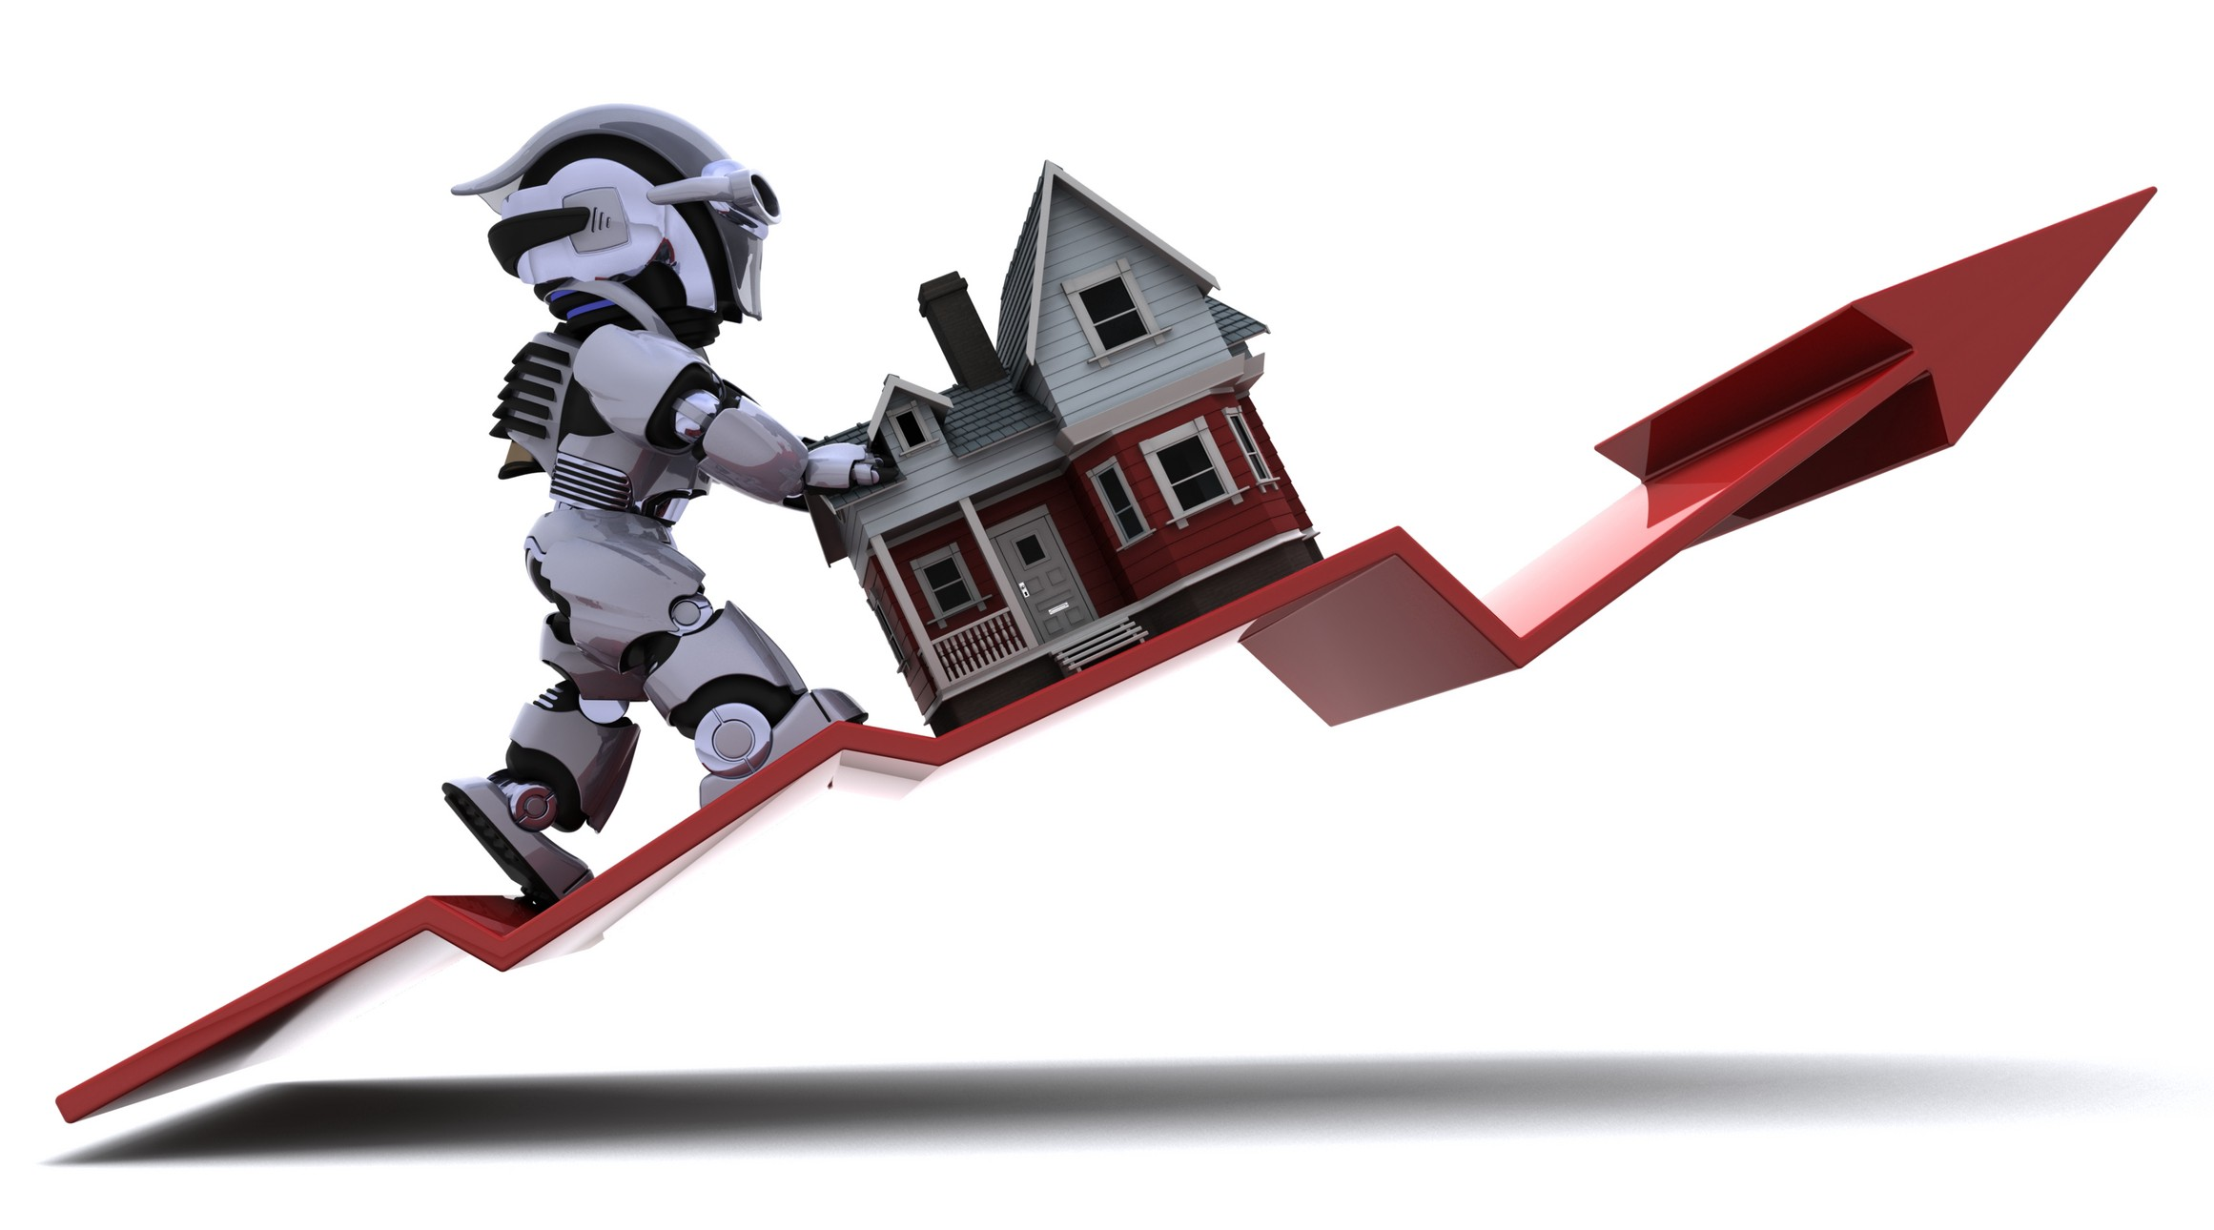
MACHINE LEARNING HOUSE PRICE PREDICTION

Slide 2
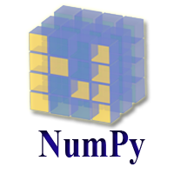
library used
NumPy
NumPy stands for Numerical Python and it is a core scientific computing library in Python.
It provides efficient multi-dimensional array objects and various operations to work with these array objects.

Slide 3

PANDAS
Pandas is a Python library used for working with data sets.
It has functions for analyzing, cleaning, exploring, and manipulating data.
Pandas allow us to analyze big data and make conclusions based on statistical theories.

Slide 4
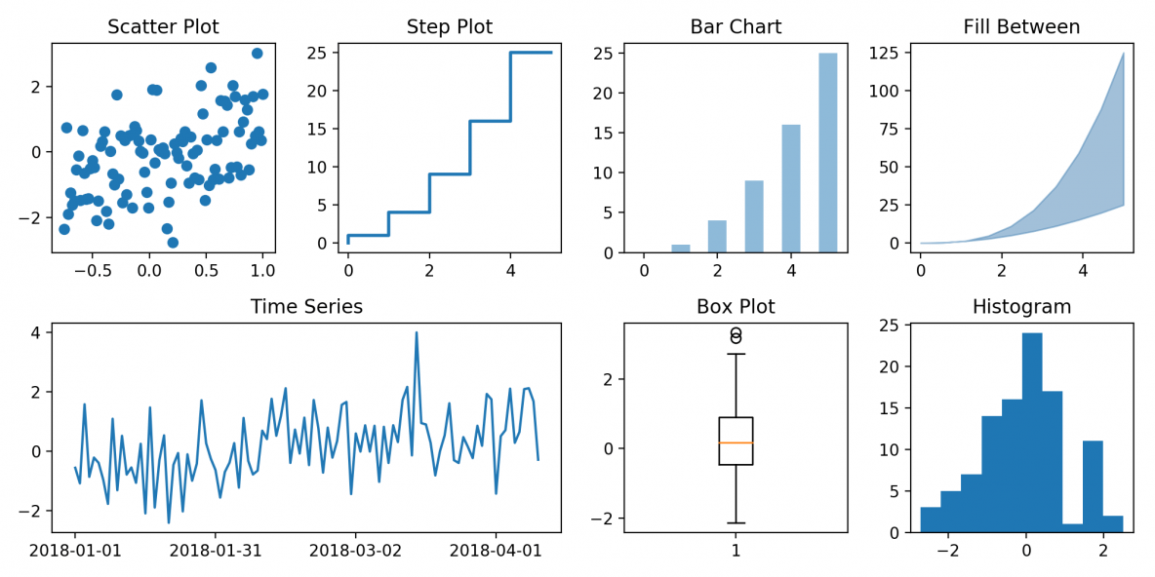
MATPLOTLIB
Matplotlib is an amazing visualization library in Python for 2D plots of arrays. Matplotlib is a multi-platform data visualization library built on NumPy arrays and designed to work with the broader SciPy stack.

Slide 5
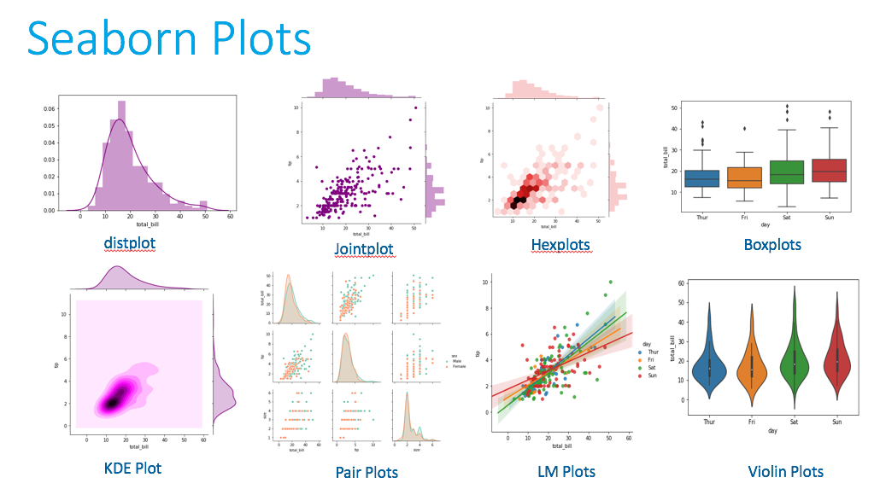
SEABORN
It is built on the top of matplotlib library and also closely integrated to the data structures from pandas.
Seaborn is an amazing visualization library for statistical graphics plotting in Python.
It provides beautiful default styles and colors to make statistical plots more attractive.

Slide 6

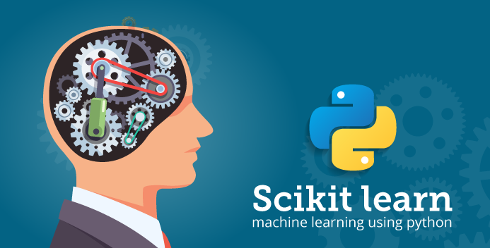
Scikit-learn
Scikit-learn is an open-source machine learning library that supports supervised and unsupervised learning. It also provides various tools for model fitting, data preprocessing, model selection and evaluation, and many other utilities. Scikit-learn provides dozens of built-in machine learning algorithms and models, called estimators.

Slide 7
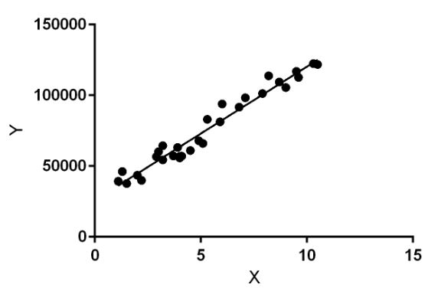
Linear Regression
Linear Regression is a machine learning algorithm based on supervised learning. It performs a regression task.
Regression models a target prediction value based on independent variables. It is mostly used for finding out the relationship between variables and forecasting. Different regression models differ based on the kind of relationship between dependent and independent variables.

Slide 8
python libraries used
import pandas as pd;
import numpy as np;
from matplotlib import pyplot as plt
%matplotlib inline
import matplotlib
matplotlib.rcParams["figure.figsize"]=(20,20)
from sklearn.model_selection import train_test_split
from sklearn.linear_model import LinearRegression

Slide 9
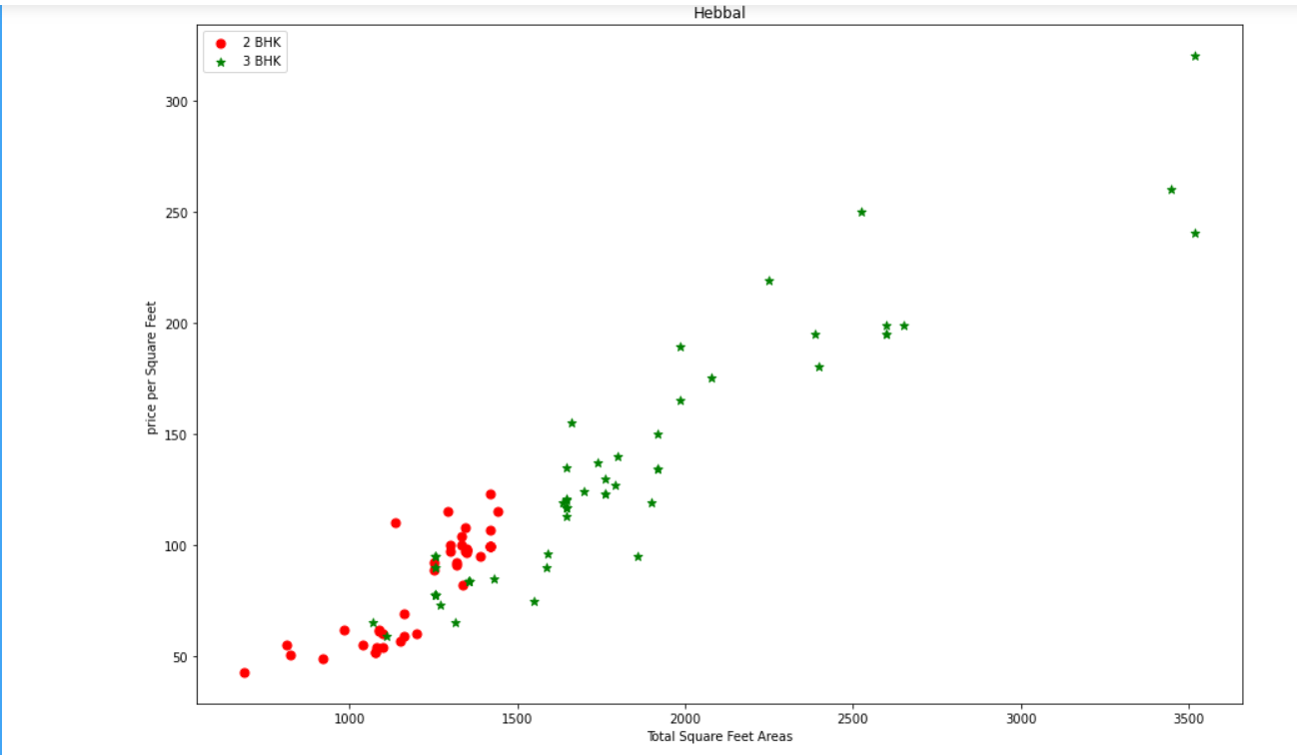

Slide 10
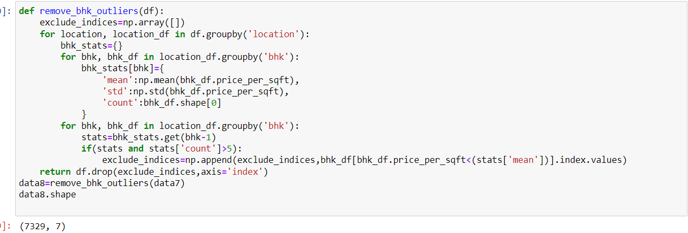

Slide 11
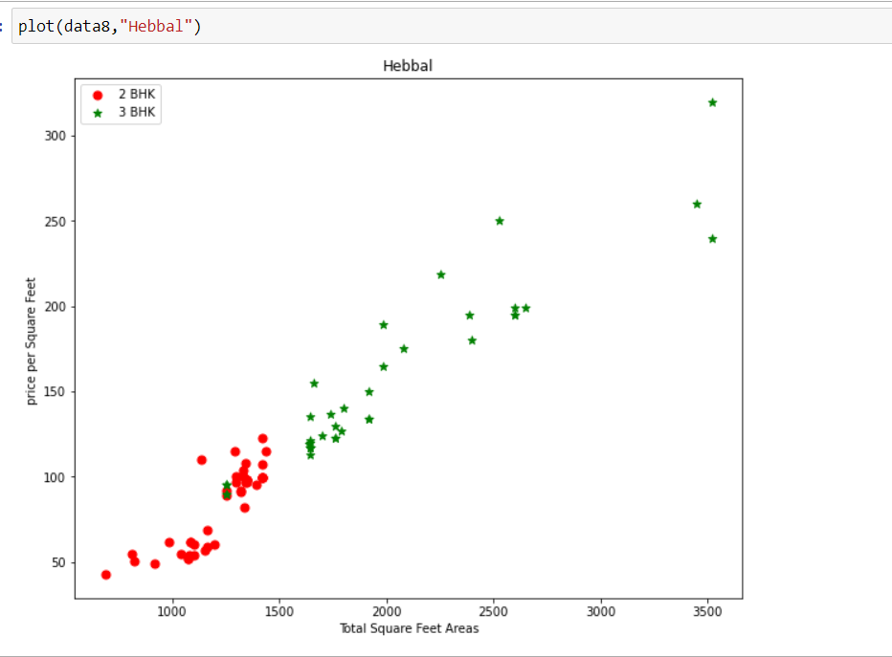

Slide 12
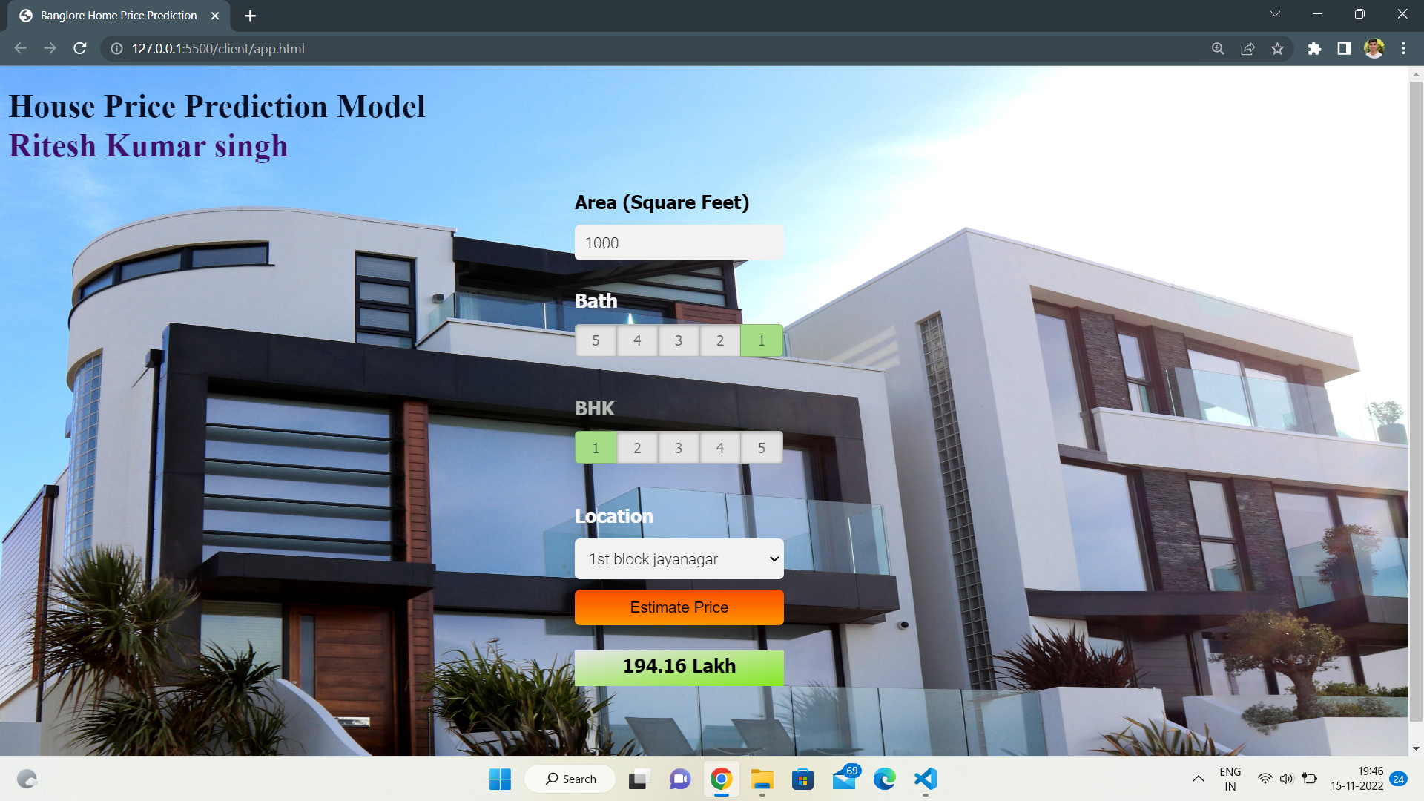

Slide 13
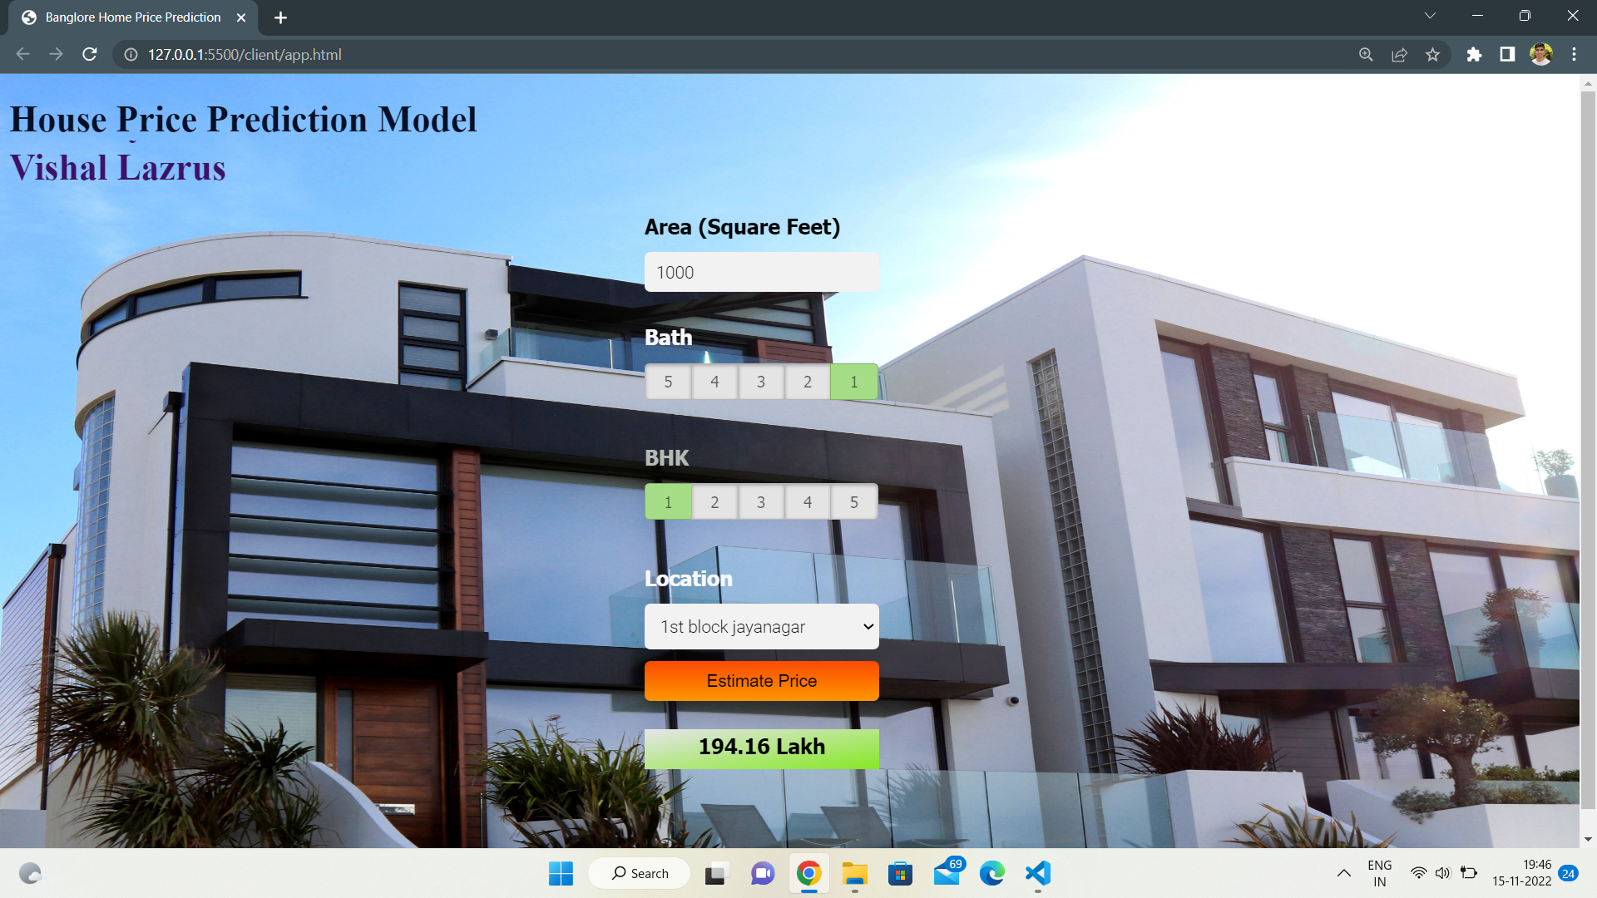

Slide 14
Conclusion
Machine learning is a great field in modern time. We can rarely imagine any application made in present time without the usage of machine learning. With the help of machine learning, we can perform several activities a human being performs and also activities which is very difficult for a human being to perform. In recent years, we have seen those devices, computers trained with machine learning models beating human beings in several fields and in several games. At last, we can surely say that machine learning is the new face of future in the field of software development.

Slide 15


